Slide 1

SVAP Presentation Team 8
Abhishek
Alekhya
Santhosh
Sushma

Slide 2


Founders: Rana Kapur and Ashok Kapur
Incorporation: November 21, 2003
Headquarter: Mumbai, India
Sector: Private
Existence: Pan India
CEO : Prashant Kumar
Over 1000 branches and 1800 ATM’s
Representative Offices in New York, USA and China
Branch offices in Singapore and London, UK, DIFC Dubai

Slide 3
Three Subsidiaries:
Yes Bank:
Offers personal banking, corporate banking & internet banking services including accounts, deposits, credit cards, home loan, personal loans
2. Yes Capital :
An Investment Banking boutique focused exclusively on Corporate Finance, Capital Raising, Mergers & Acquisitions and Strategic Advisory for the emerging corporates across India founded in 2010
3. Yes Asset Management Services:
A fully owned subsidiary of YES BANK, will seek to build a strong Mutual Fund Franchise to provide a complete suite of financial products to all its investors.

Slide 4

Investment Banking Solutions
Credit Card
Debit card
Treasury and Risk Management Solutions
Loans
Transactions Banking Solutions
Debt Capital Markets
Digital Banking

Slide 5

August 2019 : Highest stock value of INR 404
January 10, 2020 : YES Bank rejects Braich’s investment, says will launch a $1.4 billion share sale, after a board member’s resignation casts more doubt on the lender’s future
February 10, 2020 : Anup Purohit, Chief Information Officer, receives the ‘Best CIO’ award at the Indian Banks’ Association (IBA) Awards 2020 for aligning the Bank’s IT and business strategy to enhance customer experience.
February 12,2020 : Bank says it received non-binding expressions of interest from JC Flowers, Tilden Park Capital Management, OHA (UK) and Silver Point Capital.

Slide 6

March 5, 2020 : India places YES Bank under moratorium, with RBI taking over from its board for 30 days and imposing limits on withdrawals to protect depositors
March 6, 2020 : Record low of INR 5.65, $1.8 million
The Reserve Bank of India (RBI) took control of Yes Bank.
Private banks have also joined the rescue act, with ICICI Bank, HDFC Bank, Axis Bank and Kotak Mahindra Bank among others committing investments.
Prashanth Kumar – New CEO
March 17, 2020 : Shares of Yes Bank, which plunged to a life-low of 5.65 rupees earlier this month after the RBI took control, closed up 58.09% at 58.65 rupees
March 18,2020 : RBI moratorium on YES bank lifted
The share price jumped 1,484 percent from its record low of Rs 5.55

Slide 7

March 22, 2020 : CORONA impact
June 23, 2020 : Sold 16,61,008 equity shares of Sical Logistics Limited
July 8, 2020 : Sold 1,66,50,000 equity shares of CG Power & Industrial Solutions Limited
Then…
Stocks kept dropping…

Slide 8
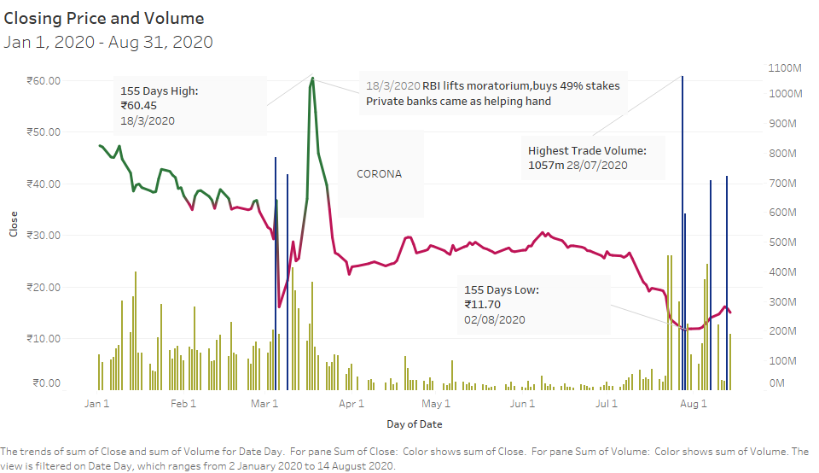

Slide 9
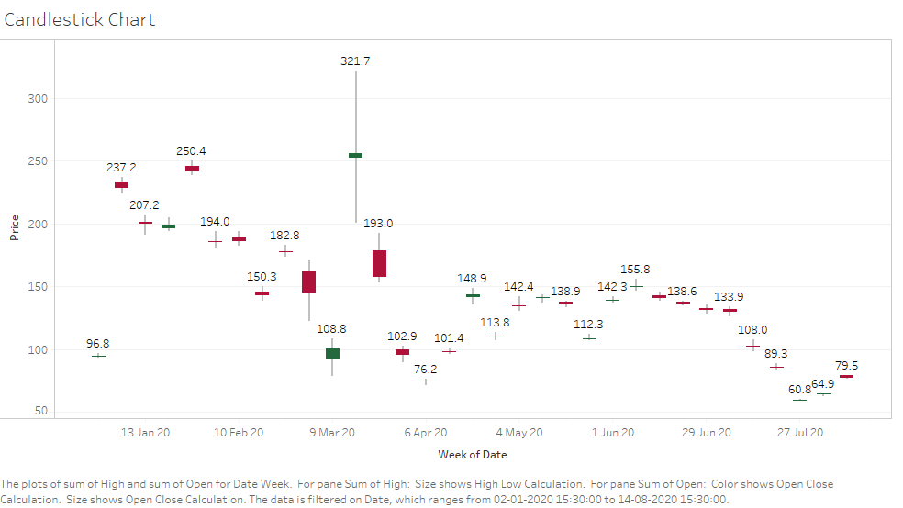

Slide 10
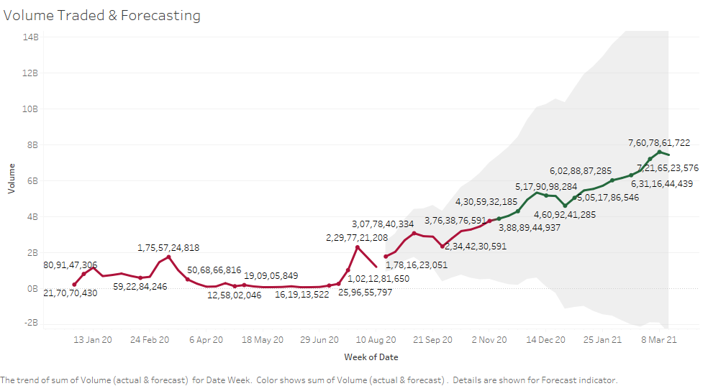

Slide 11
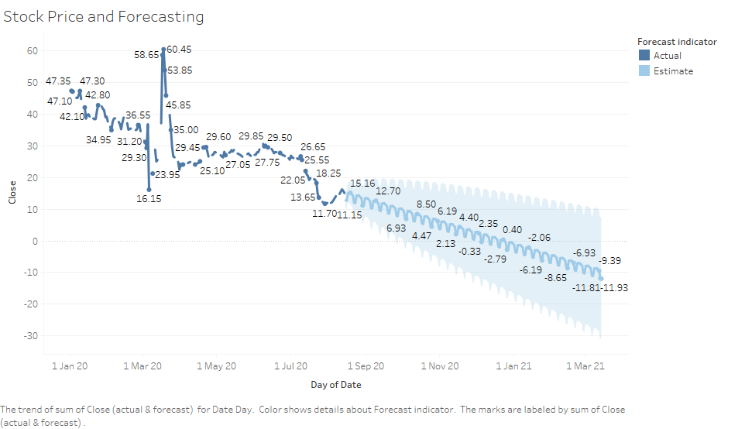

Slide 12

BCG Matrix
Debit card
Equity
Safety Deposit Lockers
Loans
Capital Markets
Market Growth
Deposits
Investment Banking
Credit cards
Transactions
Market Share

Slide 13


Slide 14

Competitive Strengths:
Public-private ownership model
Strong technology backbone
Strong focus on retail and SME advances
Pan India presence

Slide 15

Weakness:
Inefficient use of shareholder funds - ROE declining in the last 2 years
Inefficient use of assets to generate profits - ROA declining in the last 2 years
Poor cash generated from core business - Declining Cash Flow from Operations for last 2 years
Declining Net Cash Flow and Cash from Operating Activity for last 2 years
Low Piotroski Score : Companies with weak financials

Slide 16

Opportunities:
Worldwide Market
Decrease in NPA in recent results
Awareness in Digital Media
Business goals towards lower and middle income groups

Slide 17

Threats:
Security issues
Global Competitors

Slide 18

Highest share price on March 18, 2020 - INR 60.45
Highest volume traded was on August 28,2020 of value 1,057 Millions
Increase in the volume traded through forecasting
Continuous downfall of the stock prices depicted through forecasting
Lowest share price was encountered on March 6, 2020 – INR 5.65

Slide 19
Thank you!

